Slide 1
Economic Implications of Brexit
Alan V. Deardorff
University of Michigan
For panel on Brexit: Why It Matters
Michigan Journal of International Affairs
April 6, 2016

Slide 2
Background
Conservative Prime Minister David Cameron promised
To renegotiate the terms of UK membership
Then hold a referendum on membership
Referendum is now scheduled for June 23
Opinion is rather evenly divided between
Remain
Leave

Slide 3
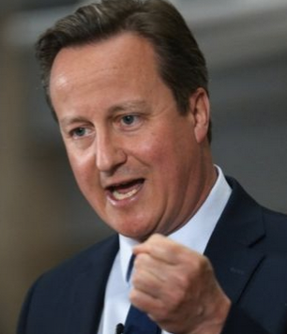
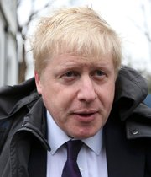
Remain
Leave
David Cameron, Prime Minister
Boris Johnson, Mayor of London

Slide 4
Procedure
“If Britons vote to leave, Article 50 of the Lisbon Treaty will come into force, giving the remaining 27 nations of the bloc up to two years to unwind their 43-year marriage to Britain and negotiate a new arrangement.” (NYT 4/2/16)

Slide 5
Economic Implications
Payments
Will no longer have to pay money into the EU budget
Will no longer benefit from EU payments into the UK
UK net annual contribution is $12.1 billion
Regulation
Will no longer be subject to EU rules
Financial Markets
London may lose its status as Europe’s financial center

Slide 6
Economic Implications
Currency and Migration: No effect, as UK is not a member of
Euro Zone
Schengen Area
Trade – See below

Slide 7
Trade Implications
By leaving the EU, UK will
Leave the EU Customs union
Be subject to tariffs on trade with EU 27 members
Leave the 30 Free Trade Agreements (FTAs) that EU has negotiated with other countries
Be subject to tariffs on trade with all of them
Be free lower (& perhaps raise, subject to WTO rules) its own tariffs

Slide 8
How Trade Negotiations Have Changed
The EU’s 11 FTAs: With Europe
1972 Iceland | 2008 Bosnia & Herzeg.
1972 Switzerland | 2008 Serbia
1973 Norway | 2014 Moldova
2001 Macedonia | 2014 Ukraine
2006 Albania | 2014 Georgia
2007 Montenegro
Years are dates FTAs on goods were signed.

Slide 9
How Trade Negotiations Have Changed
The EU’s 8 FTAs: With Africa
1995 Tunisia | 2002 Algeria
1996 Morocco | 2008 Côte d'Ivoire
1999 South Africa | 2009 Cameroon
2001 Egypt | 2009 Eastern & Southern African States Interim EPA
Years are dates FTAs on goods were signed.

Slide 10
How Trade Negotiations Have Changed
The EU’s 5 FTAs: With Middle East
1977 Syria | 1997 Palestinian Auth
1995 Israel | 2002 Lebanon
1997 Jordan
Years are dates FTAs on goods were signed.

Slide 11
How Trade Negotiations Have Changed
The EU’s 6 FTAs: With Other
1970 Overseas Countries & Territories | 2009 Papua New Guinea / Fiji
1997 Mexico | 2012 Colombia & Peru
2002 Chile
2008 CARIFORUM ETA*
*19 Overseas Countries & Territories (Anguilla, Aruba, …)
*14 CARIFORUM States (Antigua & Barbuda, Bahamas, …)
Years are dates FTAs on goods were signed.

Slide 12
How Trade Negotiations Have Changed
The EU’s 12 FTAs: In Process
Canada | SADC
East African Com. | Singapore
India | Thailand
Japan | US TTIP
Malaysia | Vietnam
Philippines | West Africa

Slide 13
Investment Implications
By leaving the EU, UK will
Make itself less attractive as location for multinational enterprises to serve the European market.

Slide 14
Uncertainty
Nobody knows what will happen if UK leaves
Under what terms will UK be able to negotiate FTAs with EU and others?
Will EU insist on the same requirements it now has for Norway and Switzerland?
Will it ask for even more, so as to discourage others from wanting to leave?

